Slide 1


TECHNICAL ASSESSMENT DATA ANALYTICS
Question 2
Descriptive Analytics
Predictive Analytics
Power BI Dashboard

Slide 2
Table of Content
Descriptive Analysis
Predictive Analysis
Power BI Dashboard

Slide 3
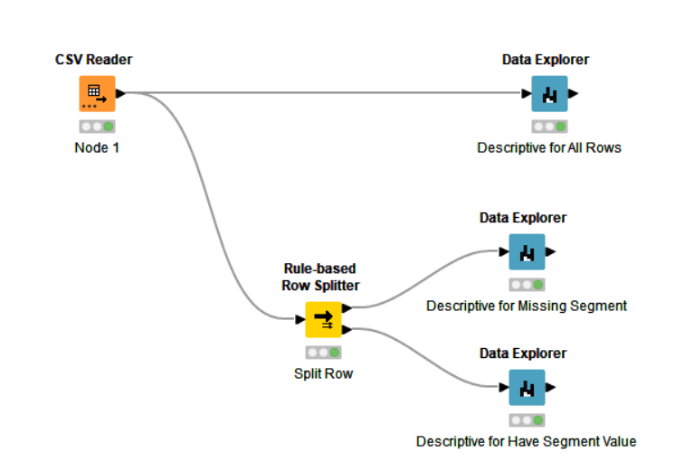
Descriptive Analytics
Using KNIME Software
Workflow to get descriptive statistics for the data
Use Rule-based Splitter to split the rows according to the rules.
In this case, split whether the Segment Title rows have values or not

Slide 4
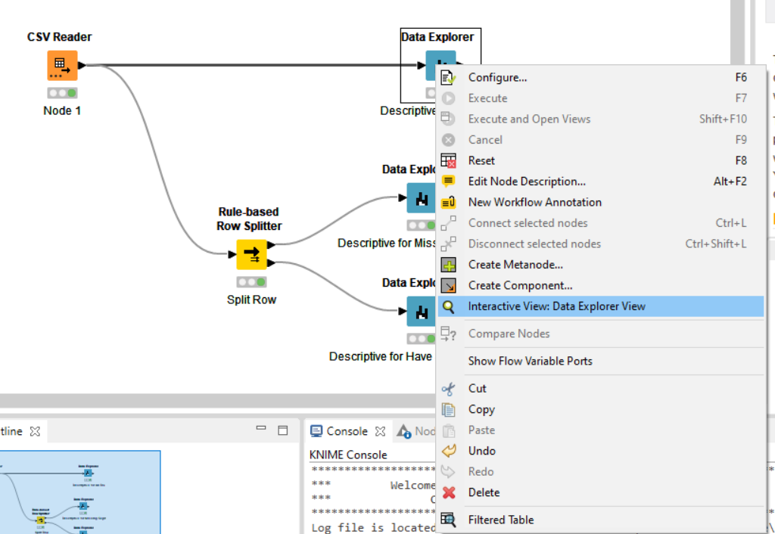
Descriptive Analytics
Right Click on Data Explorer Node to see the Interactive Node.

Slide 5
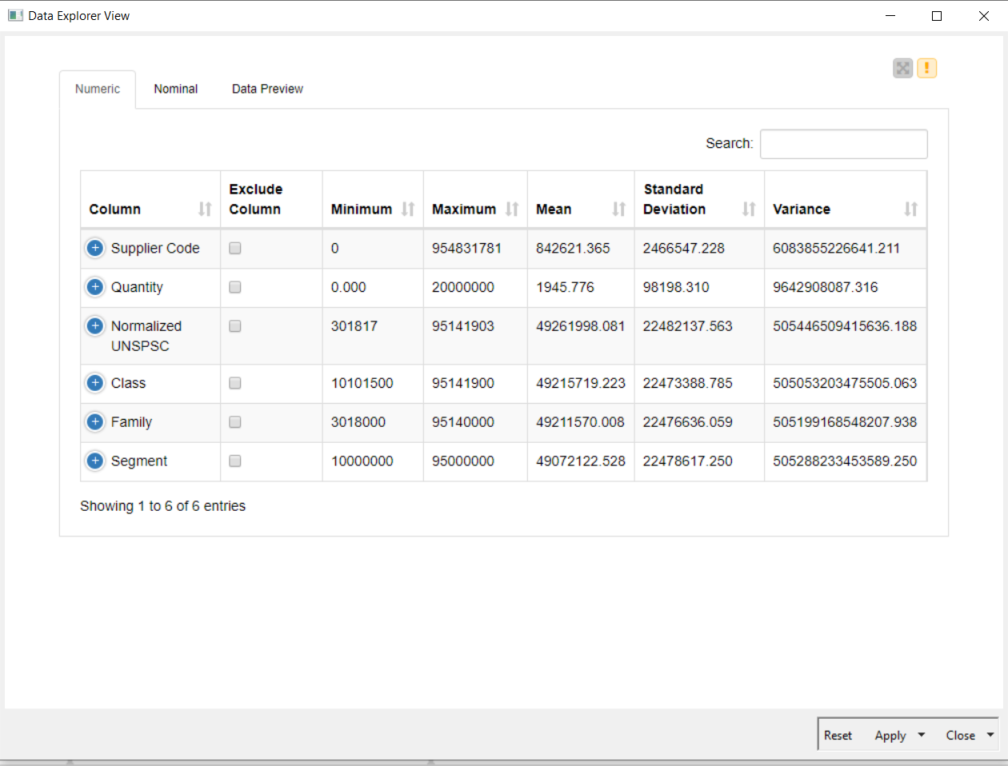
Descriptive Analytics
See all the data according to their descriptive statistics.

Slide 6
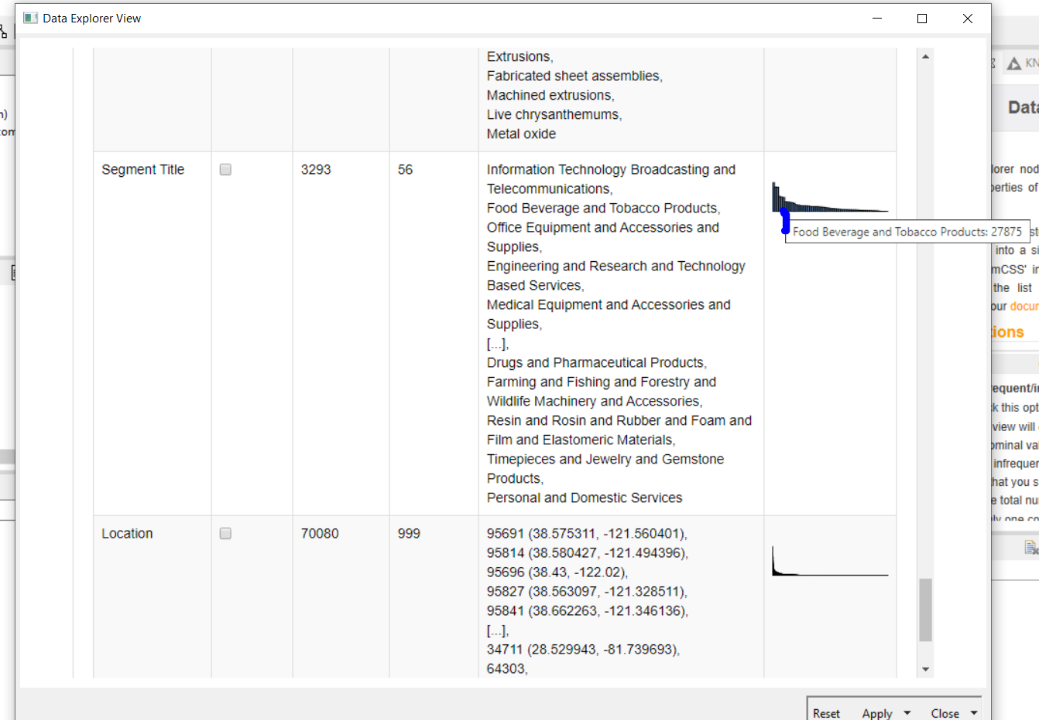
Descriptive Analytics
On
Data Explorer >
Interactive View:Data Explorer >
Nominal
We can see the distribution of the segment.
In this case, we can see the histogram of Segment Title

Slide 7
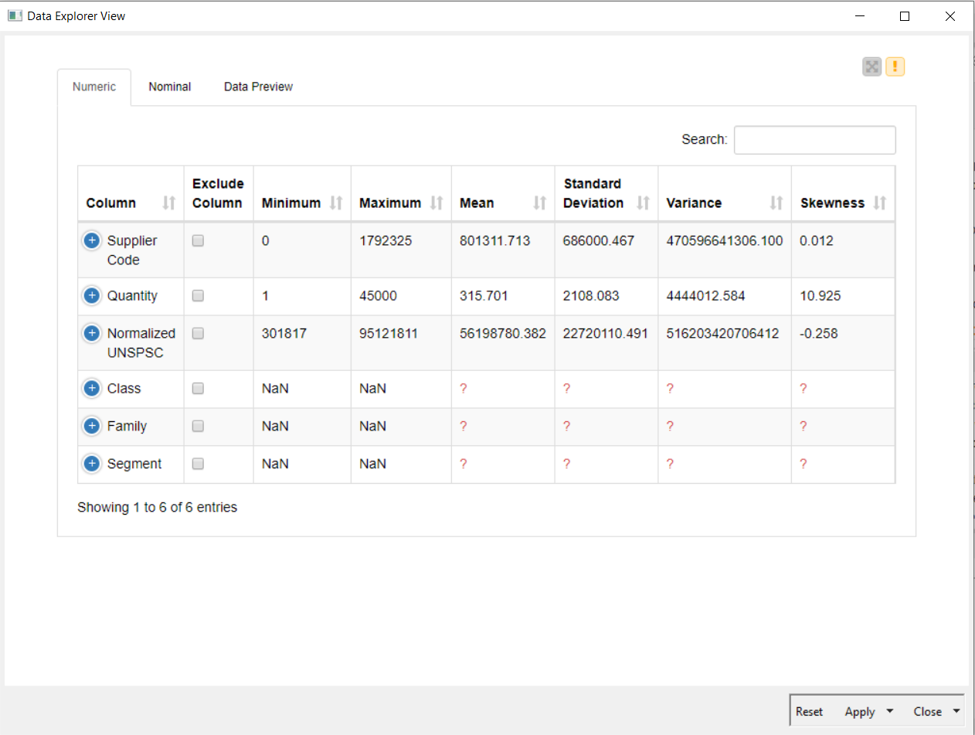
Descriptive Analytics
This is Data Explorer View when the Segment Title have missing value.
We can see some Column cannot do Descriptive Analysis because the values are missing

Slide 8
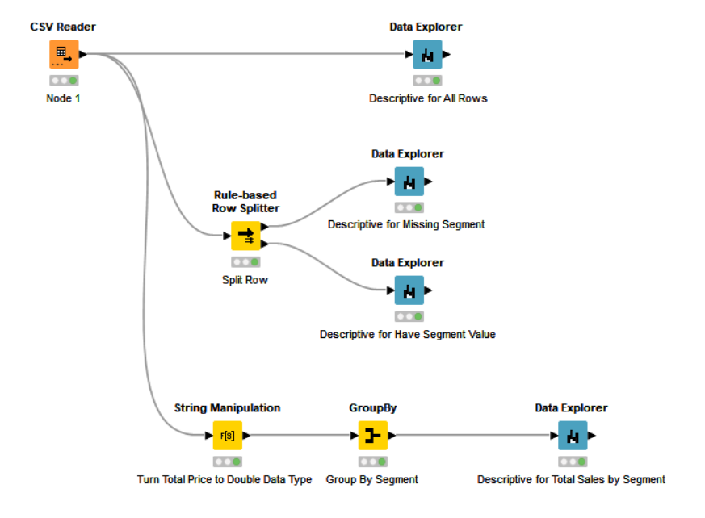
Descriptive Analytics
To see the descriptive analysis of Total Sales, some cleaning need to be done
String Manipulation
To remove unnecessary characters such as
‘$’,’(‘,’)’, and ‘,’.
And change it to Double data type
GroupBy to group it according to Segment Title

Slide 9
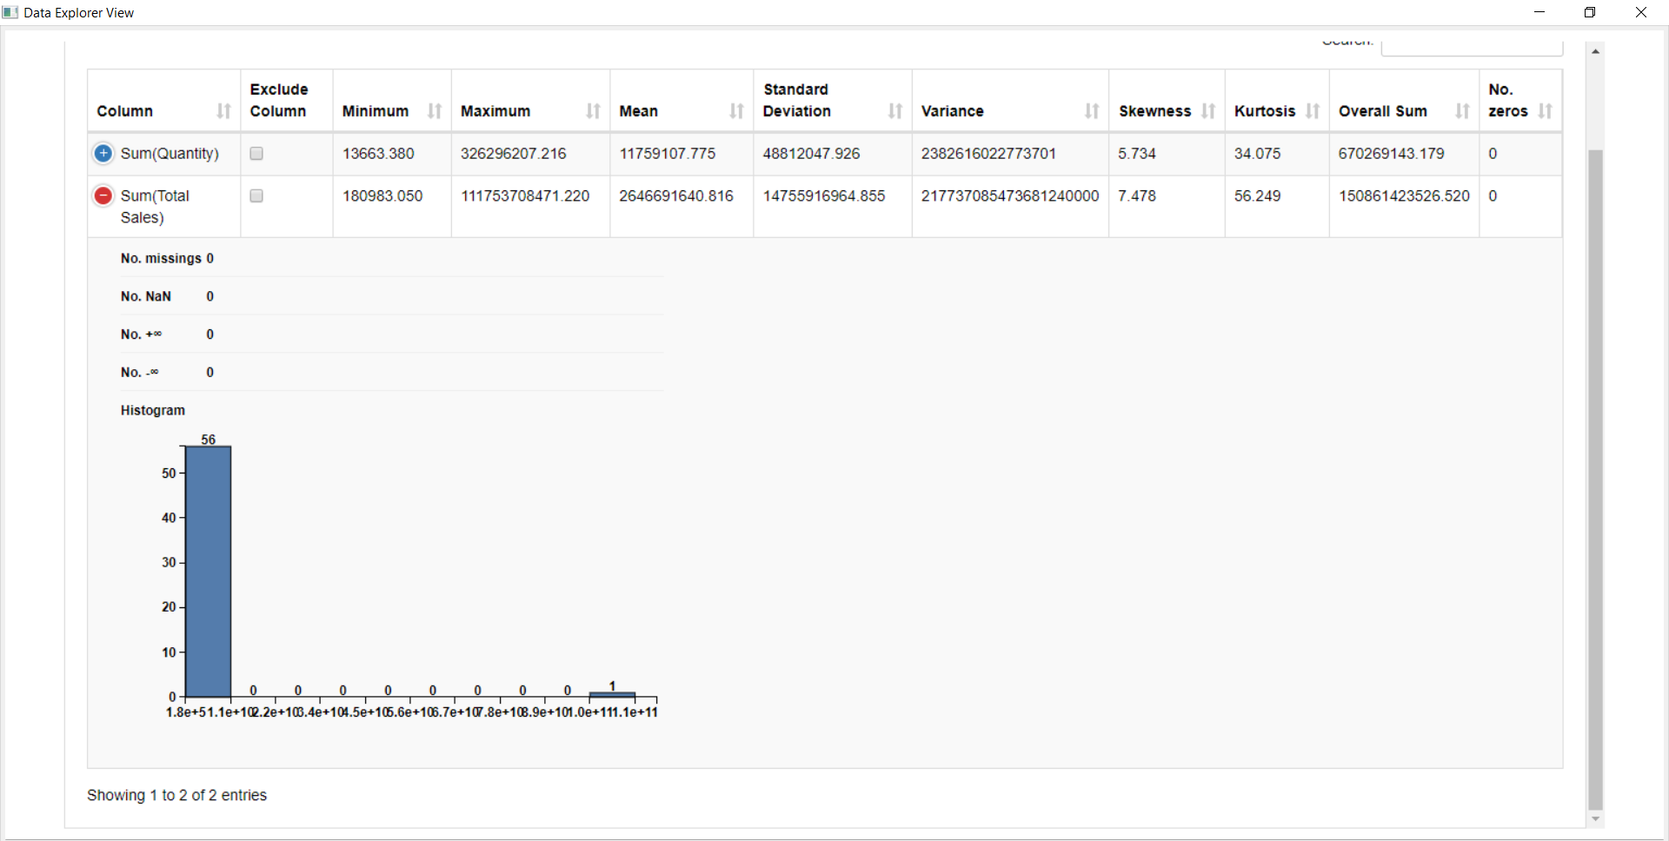
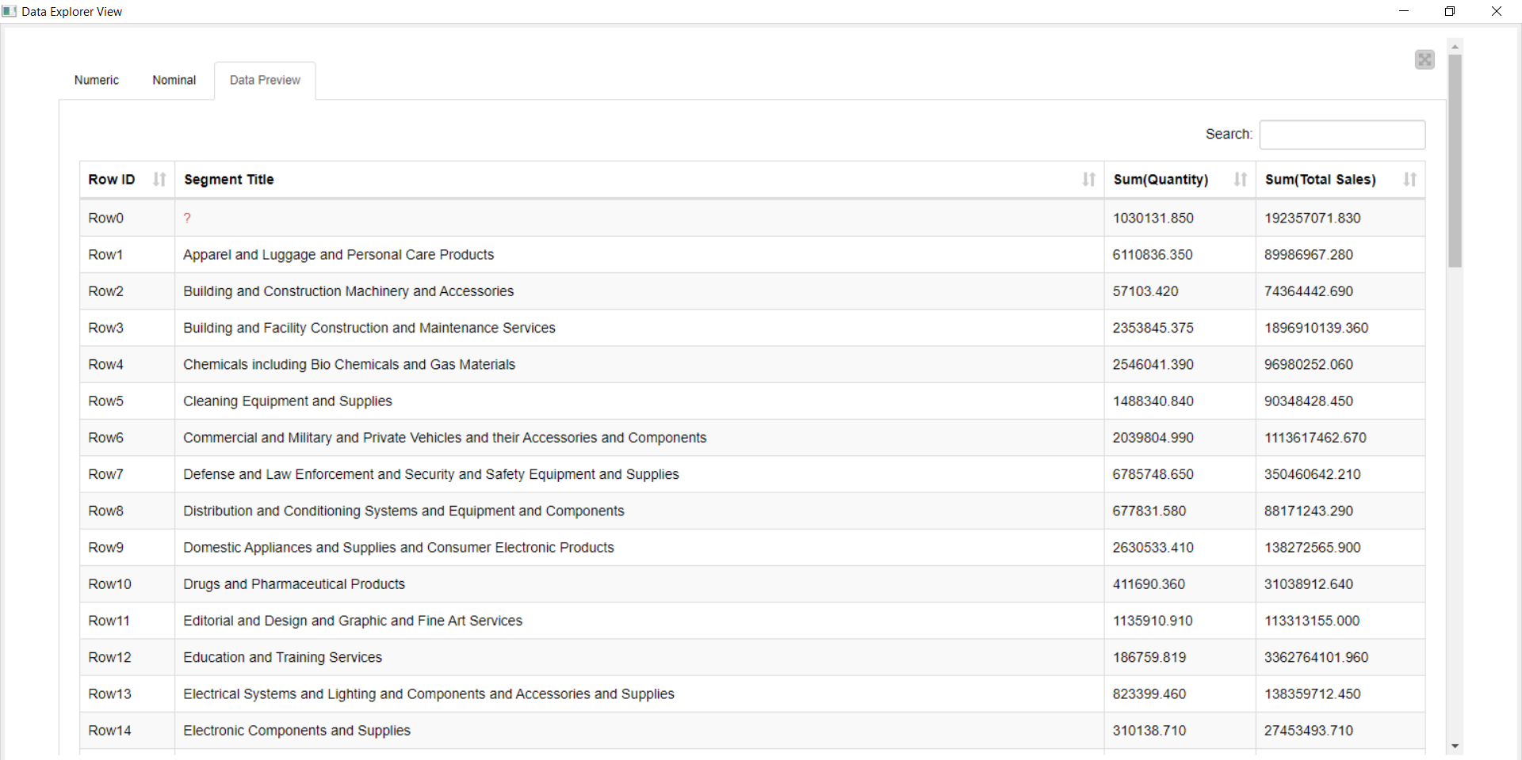
Descriptive Analytics
Here we can see descriptive analysis, after Total Sales from transformed Total Price
And the data preview of it

Slide 10
Descriptive Analytics
Here we can see descriptive analysis, after Total Sales from transformed Total Price

Slide 11
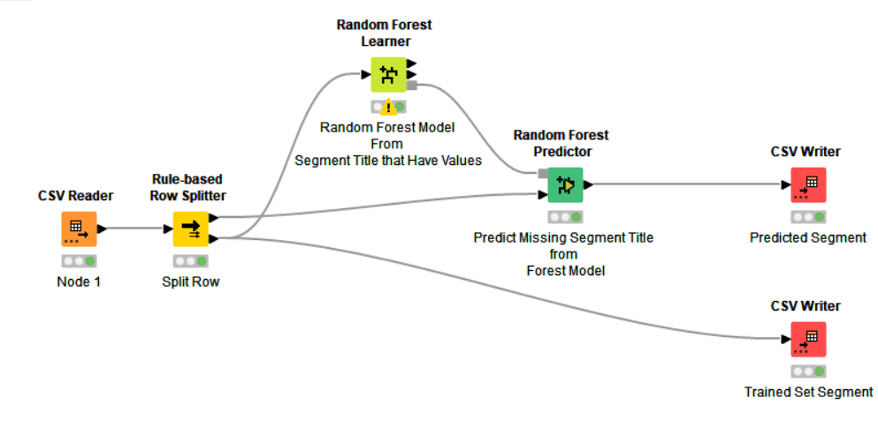
Predictive Analytics
For Predictive Analytics, we will be using KNIME
Focusing on Random Forest
Split the Row
Train – Have Segment Value
Test – Missing Segment Value
Use Train Set to Learn and Model Random Forest
Use Test Set to Predict according to Learned Model
Output Result

Slide 12
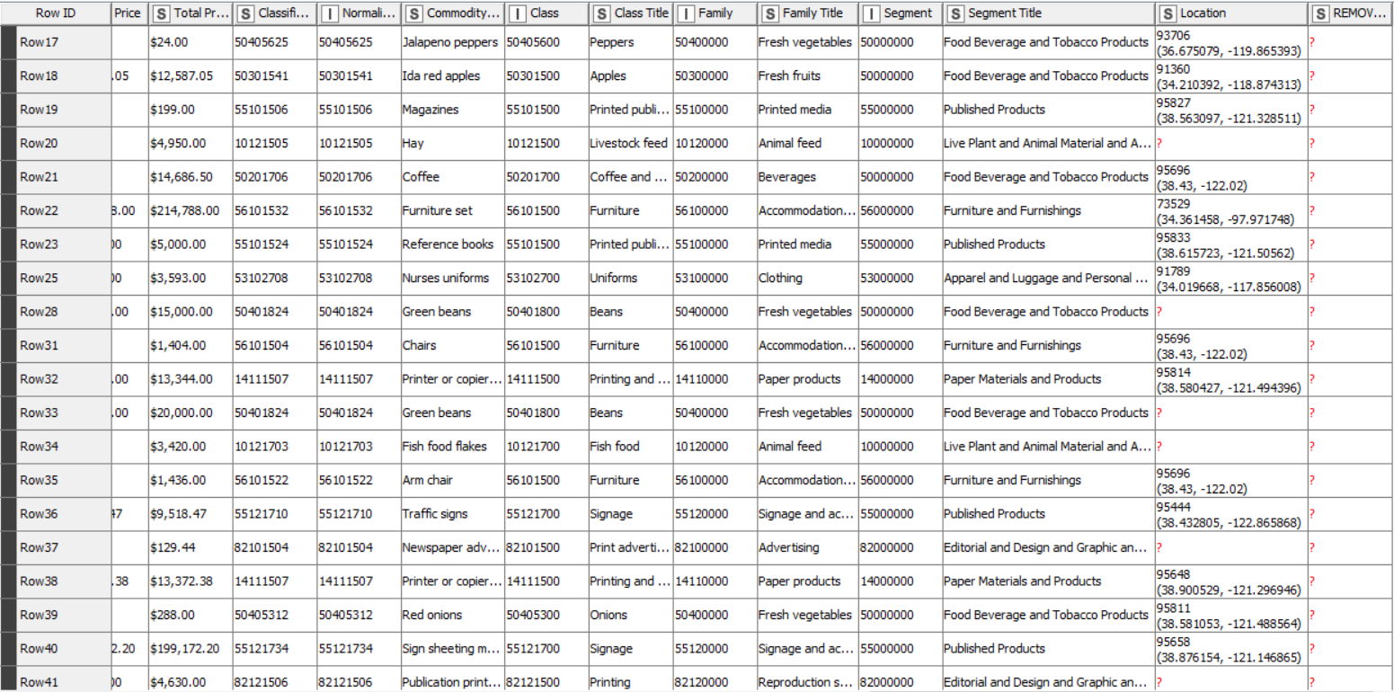
Predictive Analytics
TRAIN SET
Have Segment value
Used to train model for Random Forest

Slide 13
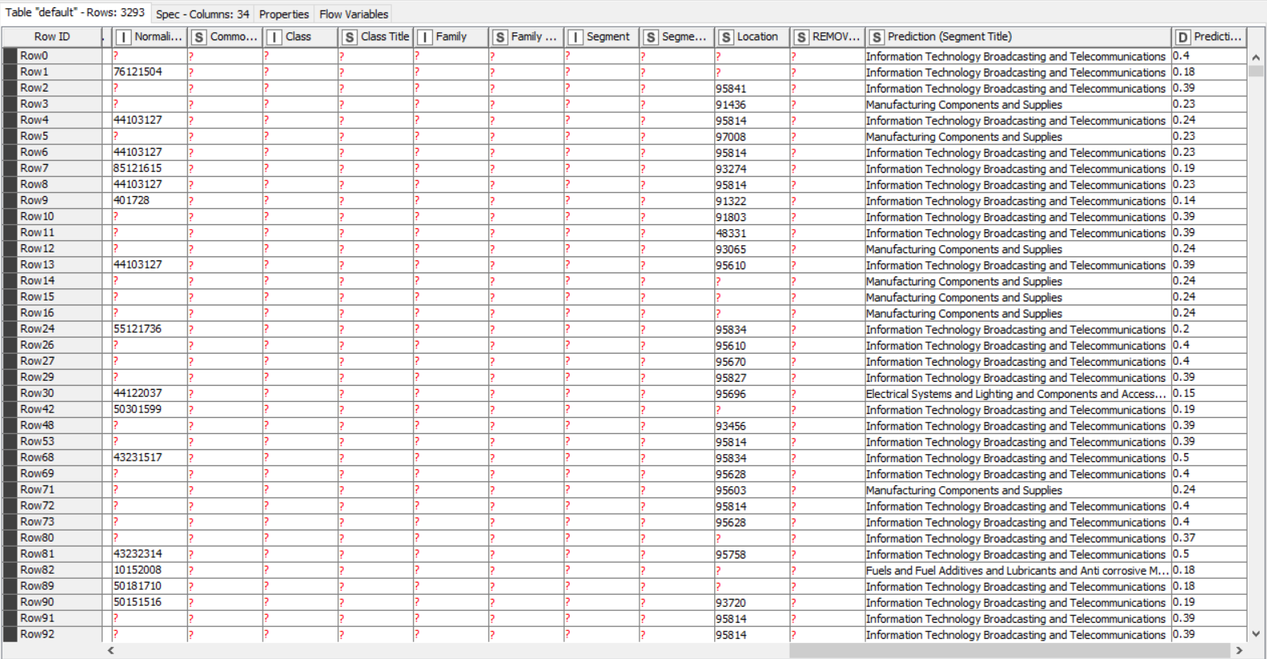
Predictive Analytics
TRAIN SET
Have Segment Title Missing Value
Use for prediction
Red Box
Shows Segment Missing Values
Green Box
Shows predicted Segment
And it’s confidence

Slide 14
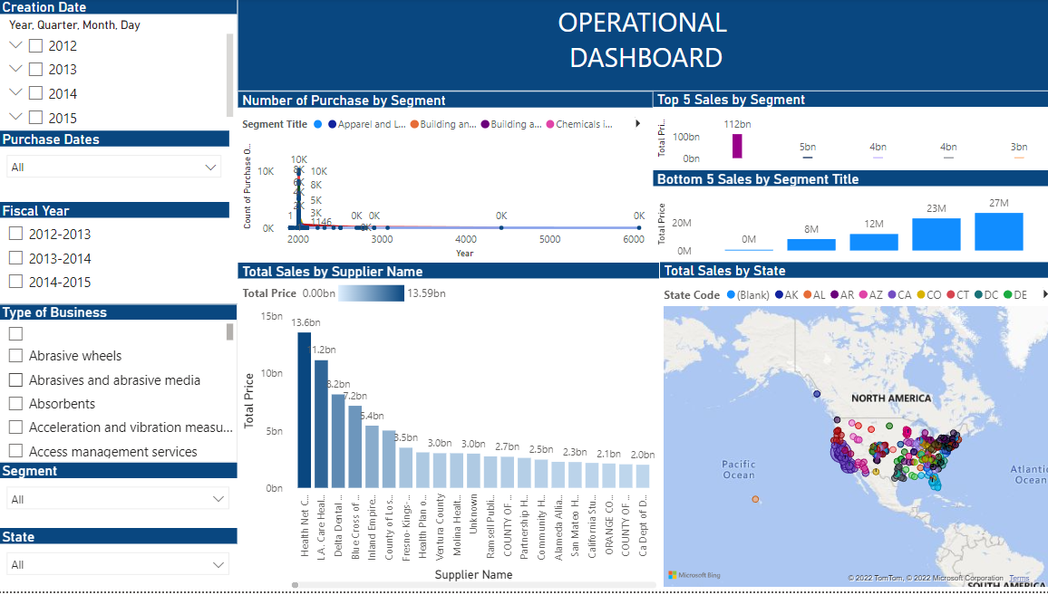
Power BI Dashboard
Operational Dashboard
Have interactive filter
More detail
From scratch

Slide 15
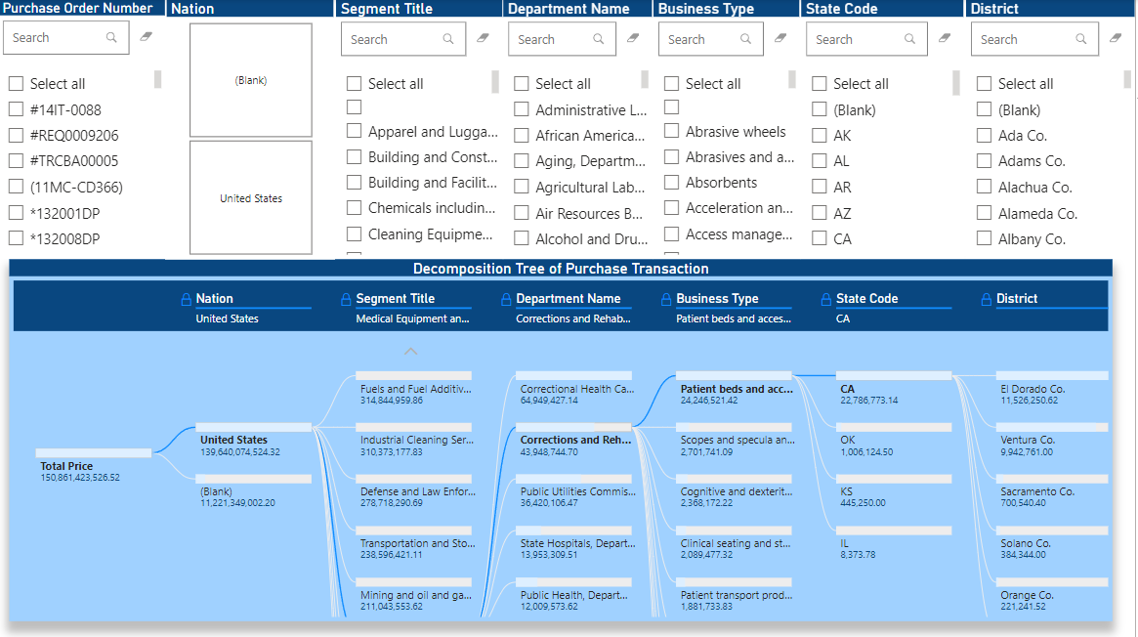
Power BI Dashboard
Decomposition Tree
To shows detail for overall composition of the transaction data

Slide 16
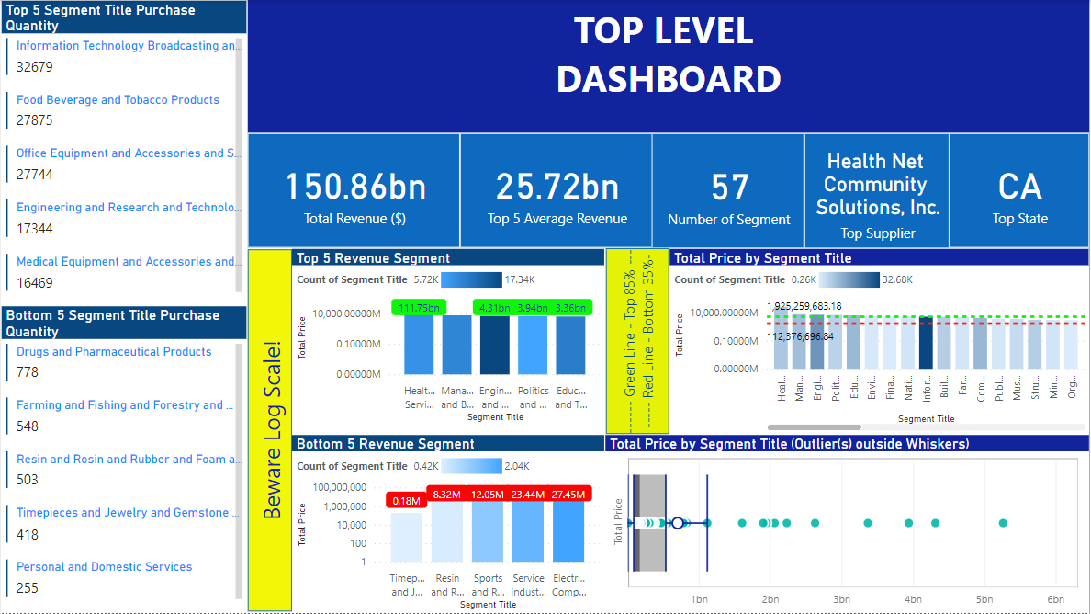
Power BI Dashboard
Top Level Dashboard
More general
Focusing on Profit and Loss
Shows outlier
Shows Important Points using Card

Slide 17
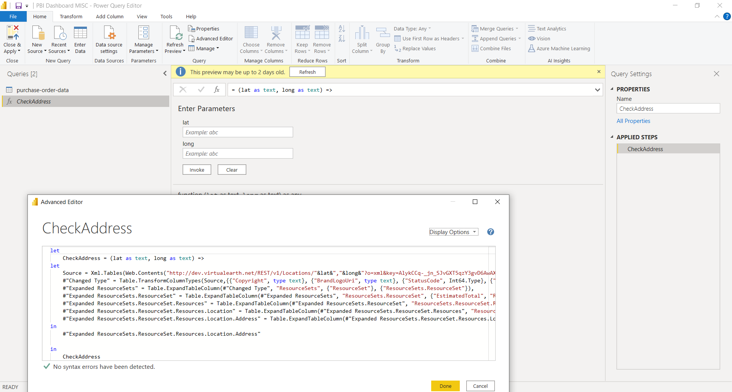
Power BI Dashboard
API Connection and Query Use
Connect with API to create Query that accept parameter
The query will be invoked accept Lat and Long from Latitude column and Longitude column to get location from the API
(The API response are slow though)

Slide 18
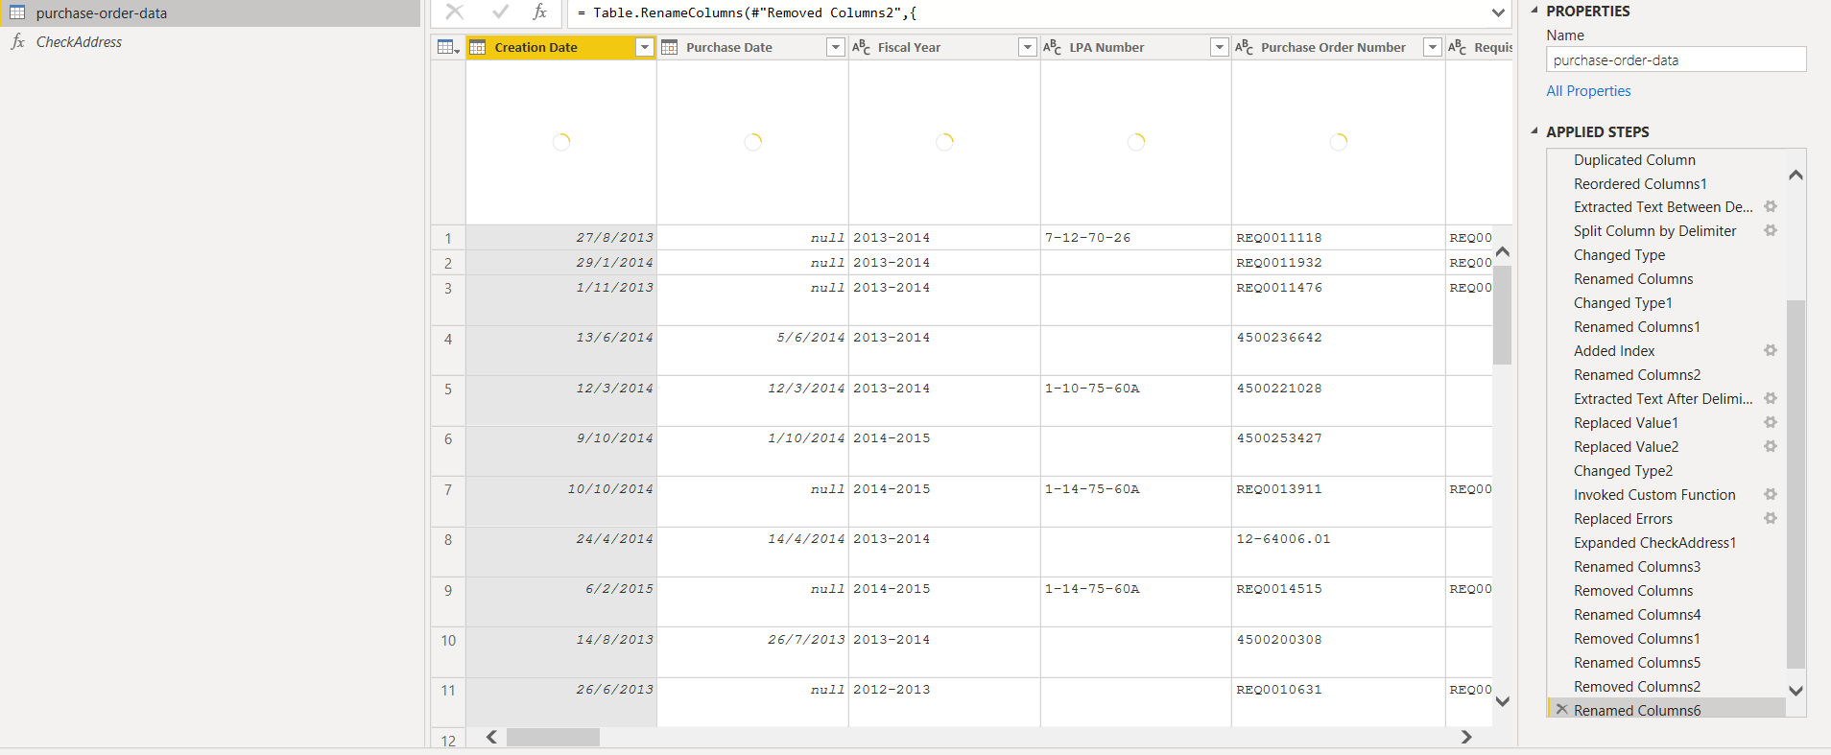
Power BI Dashboard
Power Query: Clean and Transform
All the transformation process will be being recorded on the right side of the table.

Slide 19
THE END

